Slide 1
NAME – ISHWA
BRANCH – B.tech ( CSE 4th SEM )
SUBJECT – PROJECT
SUBMITTED TO – Mr. ANKIT SIR

Slide 2
PROJECT NAME - NOTEPAD IN JAVA

Slide 3
INDEX
PROJECT OVERVIEW
INTRODUCTION
OBJECTIVE
CONTENT IN NOTEPAD
ADVANTAGE(BENEFIT)
LIMITATIONS
JAVA PROGRAMMING CODE
OUTPUT
CONCLUSION
REFERENCES

Slide 4
HARDWARE AND SOFTWARE SPECEFICATION
HARDWARE REQUIREMENTS –
Microsoft Windows – Window 10
Processor – Intel Core i5
Memory - 4.00 GB
SOFTWARE REQUIREMENT –
Operating System - Window
Application Software – Netbeans
Programming language - Java

Slide 5
Project overview
This project is about designing a simple notepad using the common features provided by Java
Here we can use various operations like cut, copy, paste etc.
The project is completely designed over common java features

Slide 6
INTRODUCTION
Java is a high-level, class based, object oriented programming language that is designed to have as few implementation dependencies as possible . It is a general-purpose programming language intended to let application developers write once, run anywhere. Java was developed by Sun Microsystems in the year 1995. Java is used to develop mobile apps, web apps, desktop apps, games and much more.
The Notepad is made in Netbeans using Java Language.
Netbeans IDE is a free, open source, integrated development environment(IDE) that enables to develop desktop, mobile and web applications. The IDE supports application development in various languages, including Java, HTML5, PHP and C++.

Slide 7
Notepad is a basic text editor.
It can used to create simple documents. The most common use of Notepad is to view or edit text (.txt) files.
It is a common text-only (plain text) editor. The resulting files typically saved with the .txt extension – have no format tags or styles, making the program suitable for editing systems files.
Easy to use implementation of Shortcut Keys for Basic Editing Functions.

Slide 8
OBJECTIVE
Notepad is a basic text editor that allows computer users to create, open and read plain text files/documents.
The main objective of this project is to edit or update the text as you want. It acts like a windows notepad so having many of the functions of it. Thus it makes a very important role in the Text Editing.
To provide a User friendly GUI, that will enable the user to work on clicks and make the software easy to use.

Slide 9
CONTENT IN NOTEPAD
The Notepad application performs text editing operations :
- File – The choices you have in the file menu are New, Open, Save, Print, Exit. As you can see many of these commands have keyboard shortcuts as well.
- Edit – Edit menu offers a few choices like Cut , Copy, Paste, Select. All the Edit choices have associated keyboard shortcuts.
- Help – We can click on this option to know About the Notepad.

Slide 10
File operations include :
- New - Begins or “opens” a brand new blank file. Shortcut for this option is (CTRL+N).
- Open - Takes you to an “Open” file window where you can select and open a document that is already saved on your computer. Shortcut for this option is (CTRL+O)
- Save - Saves the document you are working on with a new name you assign. Shortcut for this option is (CTRL+S).
- Print - If there nothing else that you want to customize in the document that you are printing, open the File menu, and click or tap Print or you can use keyboard shortcut (CTRL+P). if you do want to customize the print, first click or tap on Page Setup in the File menu.
- Exit - Exit out of Notepad with File>Exit or by using keyboard shortcut Escape .

Slide 11
Edit operations include :
- Cut – This command is used to remove the selected text from its original position. Shortcut for this command is (CTRL+X).
- Copy - This command is used to create a duplicate of the selected text. Shortcut for this command is (CTRL+C).
- Paste – The command is used to insert previously copied/cut text at cursor point. Shortcut for this command is (CTRL+V)
- Select All – This command select/high-lights whole document. Shortcut for this option is CTRL+A)
Help operations include :
- About the Notepad - This is information about Notepad.

Slide 12
ADVANTAGE
It is excellent for writing relatively short text or documents that you want to save as plain text.
Easy to work.
You can easily view, create, and edit text files, which are one of the most fundamental building blocks of modern computing.
It’s quick and lightweight. There’s no waiting for libraries and fancy features to load into memory before you can use the program.
User friendly.

Slide 13
LIMITATIONS
No support for video and audio editing. Notepad is just a text editor. If you try to paste graphics into it, it does not work.
No Fancy Text Formatting. It does not support text formatting features, such as bold, italic, or changing font sizes. We can however use symbols and punctuation for simple formatting.
It does not provide security.

Slide 14
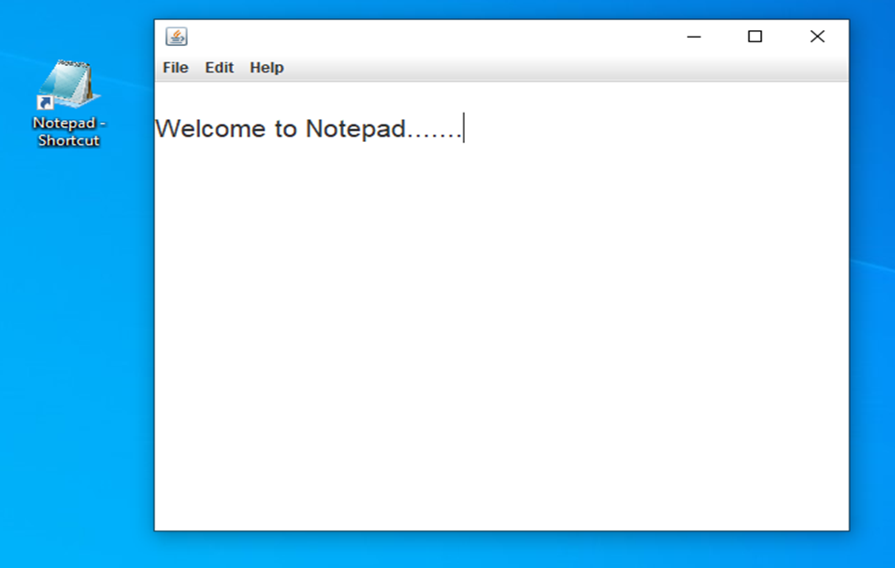
OUTPUT

Slide 15
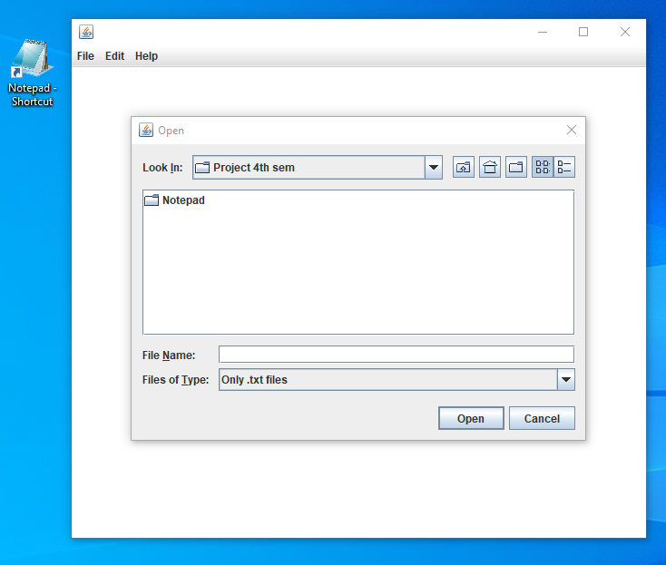
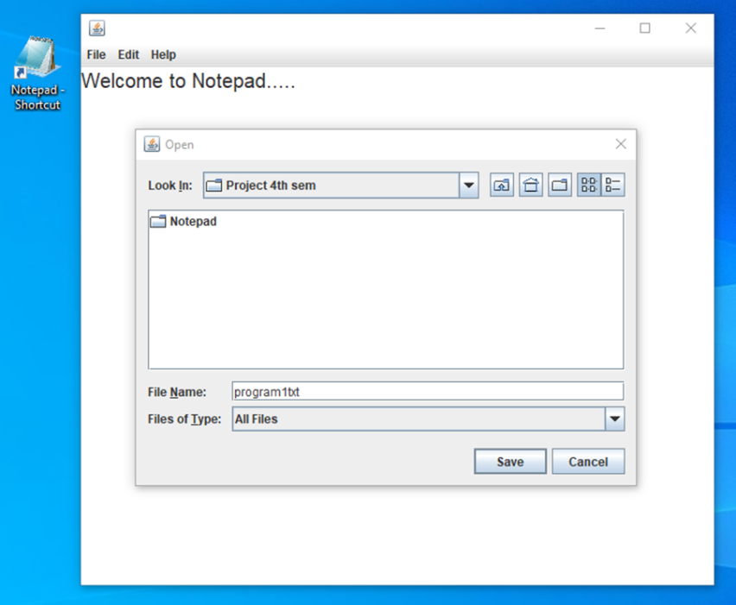
OPEN DIALOGUE BOX
SAVE DIALOGUE BOX

Slide 16
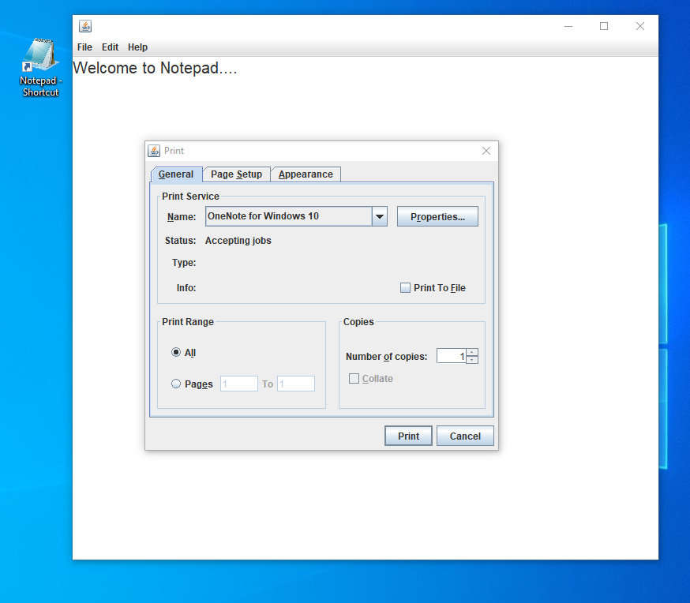
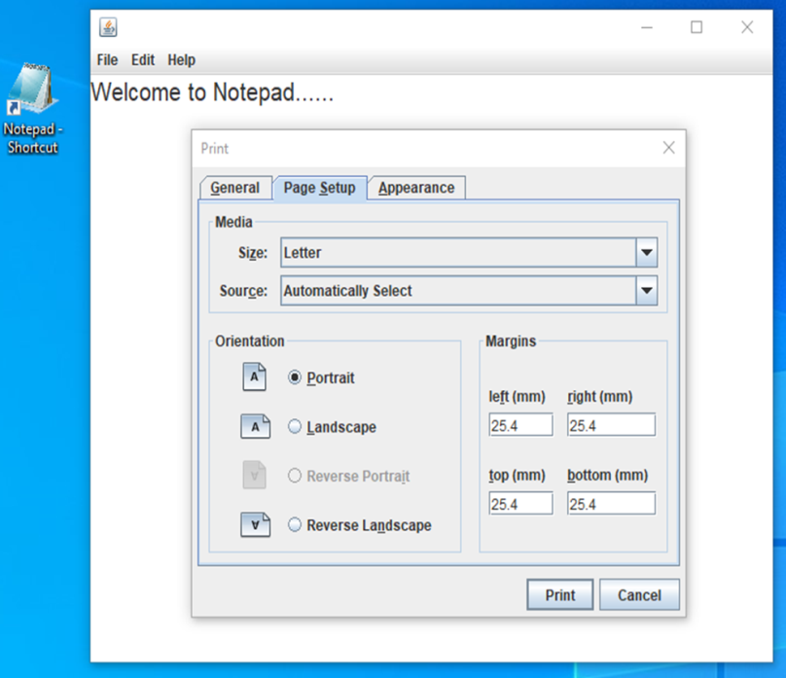
PRINT

Slide 17
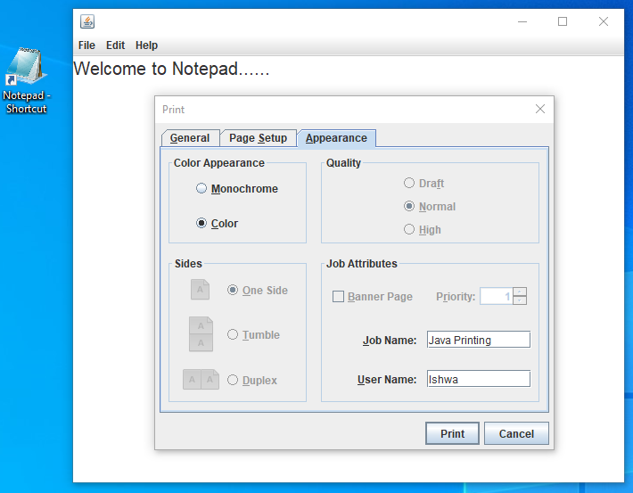

Slide 18
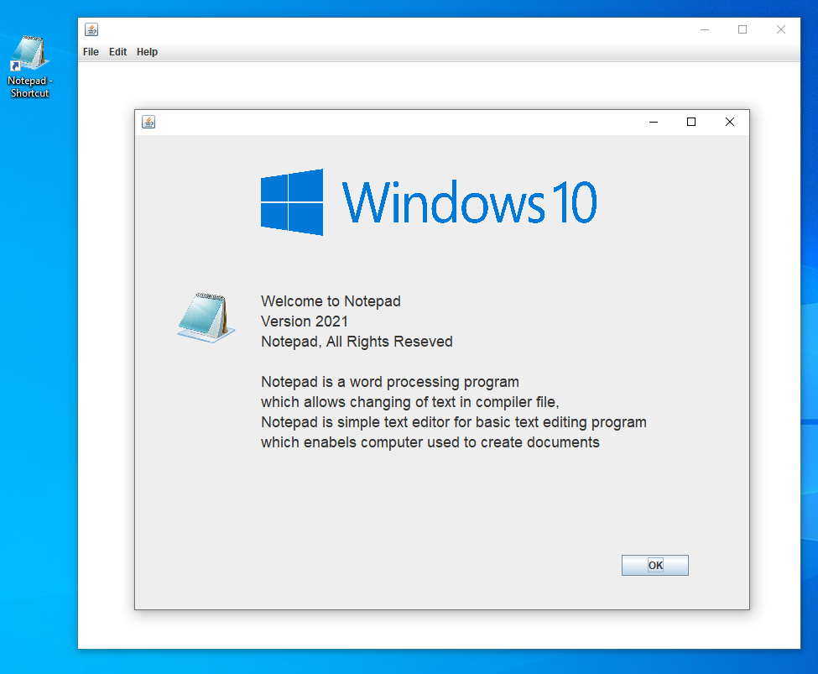
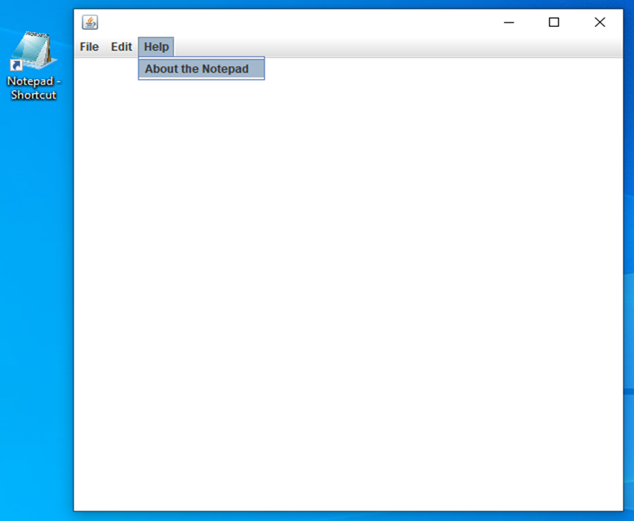

ABOUT THE NOTEPAD
Help menu

Slide 19
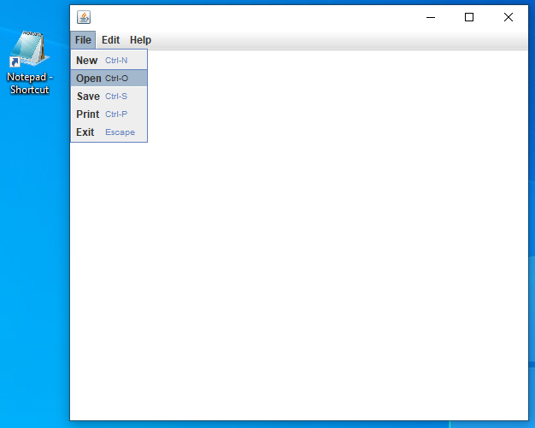

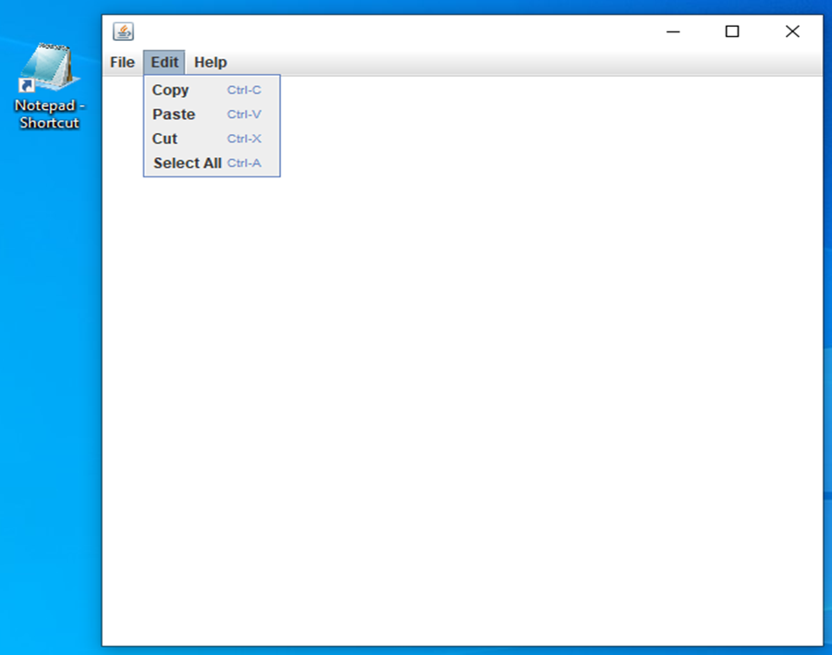
FILE menu
EDIT menu

Slide 20
CONCLUSION(RESULT)
Notepad is a basic text editor. Notepad is made in Netbeans using Java language. The purpose of notepad is to allows computer users to create, open and read plain text files/documents. It is user friendly and it is easy to use. The main objective of this project is to edit or update the text as you want. It performs basic operations like new, open, save, print, exit, cut, copy, paste, select all depending upon the users choice.

Slide 21
REFERENCES
https://en.m.wikipedia.org/wiki/Miicrosoft_Notepad
https://www.javatpoint.com/creating-edit-menu
https://www.google.com/amp/s/www.geeksforgeeks.org/java-swing-create-a-simple-text-editor/amp/

Slide 22
THANKS

